Slide 1
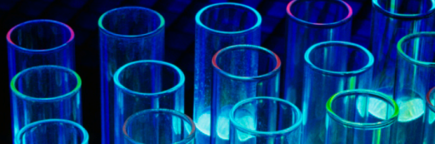
Science Project Title
Your name | Teacher’s name | School
Problem / Question
Materials
Results
Enter your question here (statement of the problem)
Materials (detailed list) | Quantity (be specific)
Item | Amount
Item | Amount
Item | Amount
Item | Amount
Item | Amount
Item | Amount
Item | Amount
Hypothesis
Add your answer / solution here
Write hypothesis before you begin the experiment
This should be your best educated guess based on your research
Project Overview
Procedure
Include results based on your experiments
Result 2
Result 3
Step 1
Describe this step in your experiment
Step 2
Describe this step in your experiment
Step 3
Describe this step in your experiment
Step 4
Describe this step in your experiment
Add a brief overview or summary of your project. (Use the Bullets button on the Home tab to remove the bullets.)
Conclusion
Brief summary of what you discovered based on results
Indicate and explain whether or not the data supports your hypothesis
Variables / Research
Data / Observations
Controlled variables
These are kept the same throughout your experiments
Independent variable
The one variable you purposely change and test
Dependent variable
The measure of change observed because of independent variable
Decide how you will measure the change
Observation 1
Observation 2
Observation 3
Works Cited
Include print and electronic sources in alphabetical order
Notes:
To change this poster, replace our sample content with your own. Or, if you'd rather start from a clean slate, press the New Slide button on the Home tab to insert a new page. Now enter your text and pictures in the empty placeholders. If you need more placeholders for titles, subtitles or body text, copy any of the existing placeholders, then drag the new one into place.

Slide 2
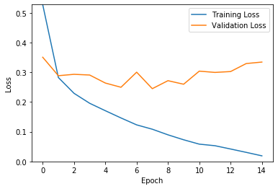
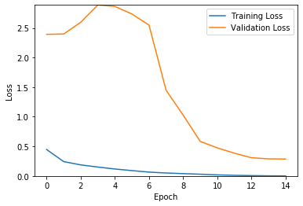
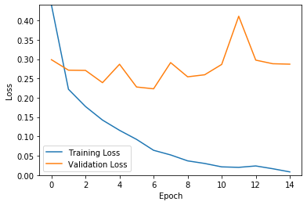
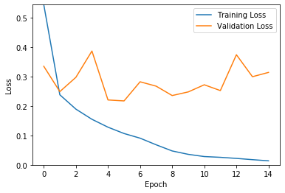
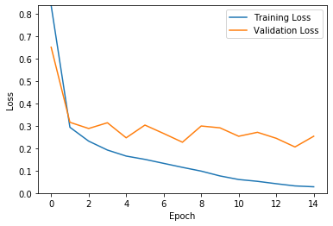
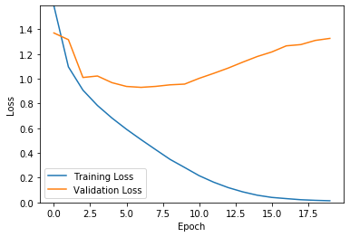
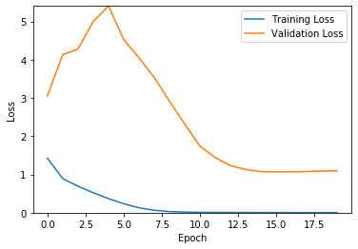
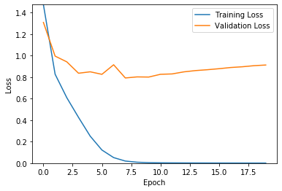
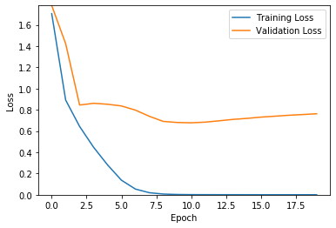
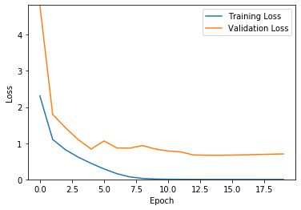
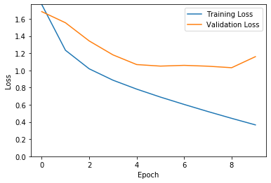
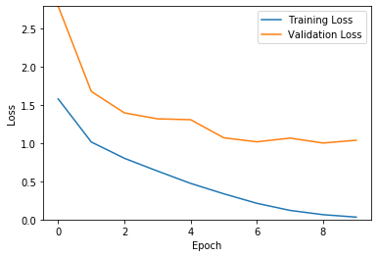
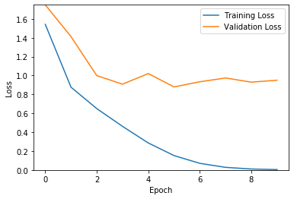
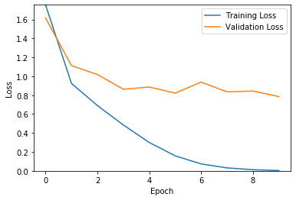
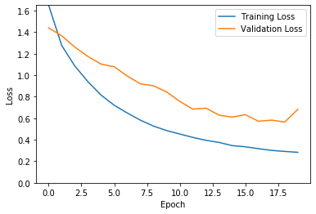
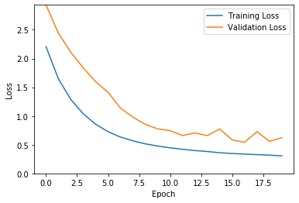
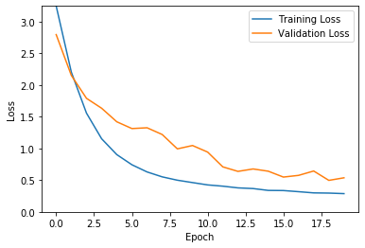
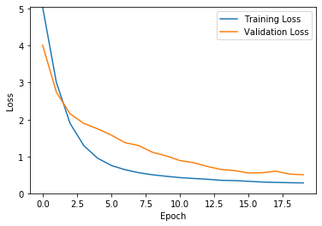
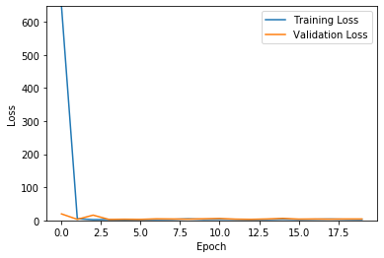
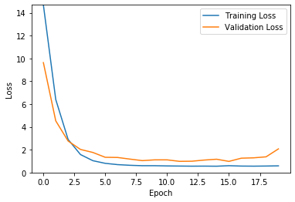
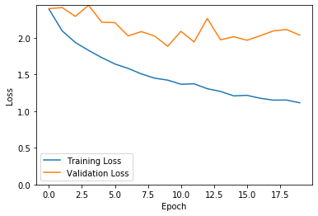
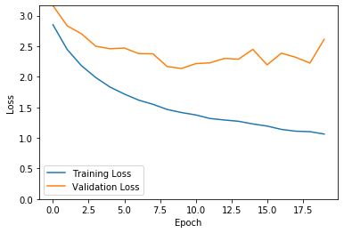
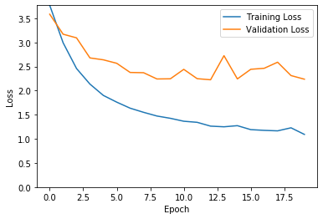
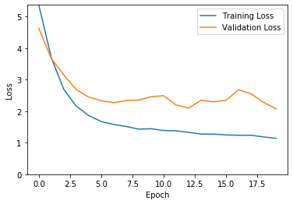
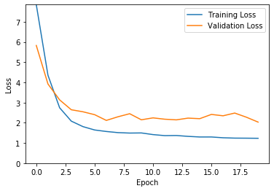
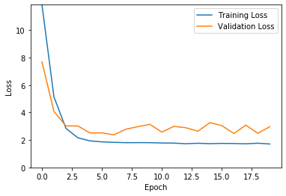
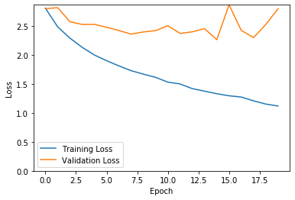
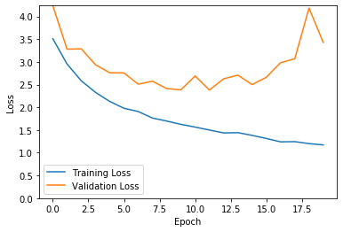
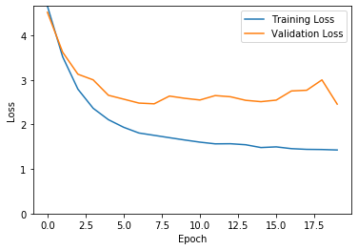
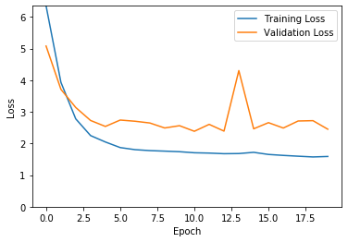
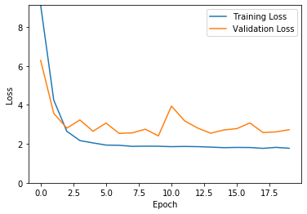
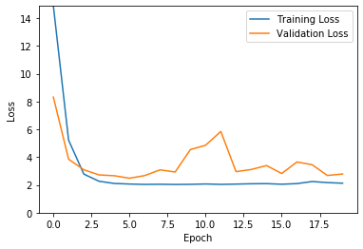
0.5 Neurons | Baseline | 2xNeurons | 4xNeurons | 8xNeurons | 16xNeurons
Convolutional Neural Network Fashion-MNIST CIFAR-10 CIFAR-10-Grayscale
Multi-Layer Perceptron Fashion-MNIST CIFAR-10 CIFAR-10-Grayscale
Not Enough
RAM

Slide 3
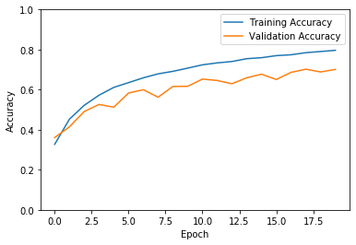
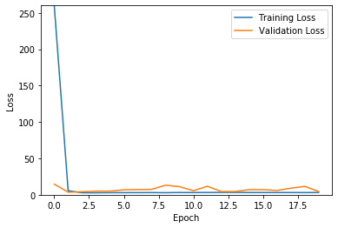
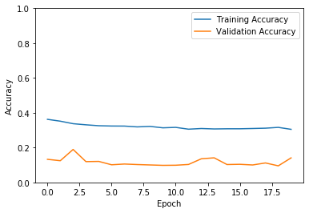
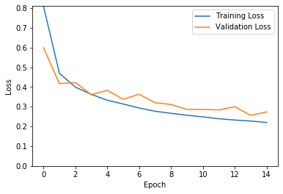
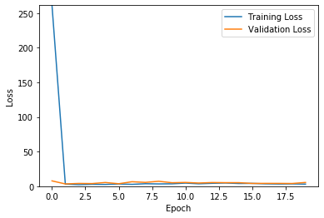
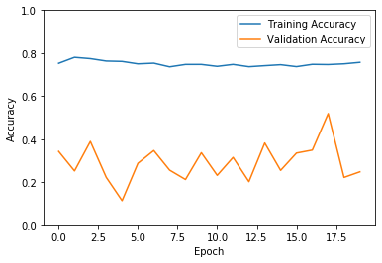
Regularization
Convolutional N.N (8 x Neurons)
Dropout Regularization(0.4)
CIFAR-10
0.70 Acc.(with
regularization)
0.82 Acc.
(without reg.)
Fashion MNIST
0.89 Acc (with Regularization
0.9258 (without Regularization)
Multi-Layer Perceptron (16 x Neurons)
L2 Regularization (0.1)
CIFAR-10
Fashion MNIST

Slide 4
Test Accuracies
CNN
CIFAR-10
Half_Baseline Neurons Test Acc: 0.6742
2xBaseLine Neurons Test Acc: 0.7603
4xBaseline Neurons Test Acc:0.80
8xNeurons : 0.8211
Dropout(0.4) : 0.7016
Cifar-10 Gray
HalfNeurons:0.6185
2xNeurons:0.7212
4xNeurons: 0.7692
8xNeurons : 0.7318
Dropout(0.4) : 0.6395
Fashion-MNIST
HalfNeurons : 0.899
2xNeurons :0.9263
4xNeurons: 0.9245
8xNeurons :0.9258
Dropout(0.4) : 0.8913
MLP
CIFAR-10
Half Neurons: 0.4134
2xNeurons:0.348
4xNeurons:0.3784
8xNeurons:0.4022
16xNeurons :0.1808
16xNeurons (0.1 L2 Regularization) :0.1374
Cifar-10 Gray
Half Neurons: 0.2884
2xNeurons:0.1804
4xNeurons:0.1938
8xNeurons:0.2231
16xNeurons :0.1885
Fashion-MNIST
Half Neurons: 0.83
2xNeurons:0.8621
4xNeurons:0.8693
8xNeurons:0.8057
16xNeurons : 0.4546
16xNeurons (0.1 L2 Regularization) : 0.2471

